Slide 1

RAG Pipelines
From Core Foundations to Highly Advanced Architectures

Slide 2
Part 1: Foundations
Understanding the Mechanics of Retrieval-Augmented Generation

Slide 3
The Rise of RAG
71%
Why the massive adoption?
Retrieval-Augmented Generation (RAG) is now the default pattern for grounding large language models in private, recent, or domain-specific data.
of Early GenAI Adopters
It solves the critical LLM limitations: hallucinations, outdated training cutoffs, and lack of access to proprietary enterprise knowledge.

Slide 4





The Three Pillars of RAG
Retrieve
Augment
Generate
Fetch relevant documents or data chunks from an external knowledge base based on the user's semantic query.
Combine the retrieved information with the original user prompt to provide rich, factual context.
Pass the augmented prompt to the LLM to synthesize an accurate, well-reasoned, and grounded answer.

Slide 5


RAG vs. Fine-Tuning
•
Dynamic Knowledge: RAG fetches real-time data. Fine-tuning requires retraining to update facts.
•
Cost & Speed: Updating a vector database is instantaneous and cheap. Fine-tuning is computationally expensive.
•
Hallucination Reduction: RAG grounds answers in verifiable citations. Fine-tuning relies on internalized parametric memory.
•
Access Control: RAG allows document-level permission filtering before generation.

Slide 6
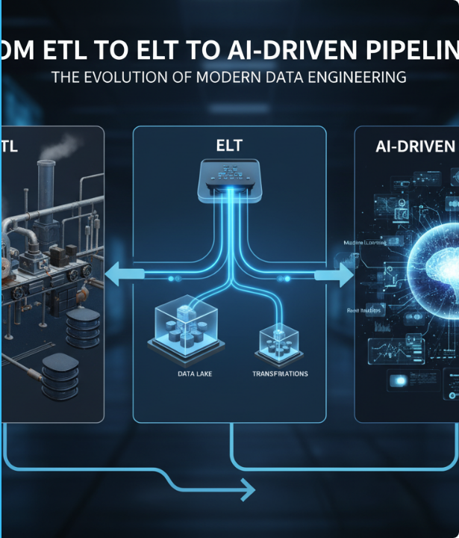
Basic RAG Architecture
The Data Pipeline
Documents are ingested, chunked into smaller segments, and converted into high-dimensional vectors (embeddings).
At inference, the user query is also embedded. The system performs a similarity search to find the nearest vector chunks, returning the context.

Slide 7
Evolution of AI Context
Pure LLMs
Agentic RAG
Relying solely on internal parametric memory (GPT-3 era).
Dynamic routing, multi-step reasoning, and web fallback.
Rule-Based
Basic RAG
Rigid databases and exact keyword matching (Pre-2010s).
Injecting external context via naive vector similarity search.

Slide 8
The Value Proposition
RAG gives large language models what they've always lacked: connected, verifiable context.
"
"
— Enterprise AI Paradigm

Slide 9


Understanding Embeddings
What is an Embedding?
The Vector Space
An embedding is a mathematical representation of text as an array of floating-point numbers (a vector). It captures the semantic meaning, context, and relationships of words, not just their spelling.
In this high-dimensional space, sentences with similar meanings are plotted closer together. A query vector for "dog" will naturally locate near documents containing "puppy" or "canine".

Slide 10

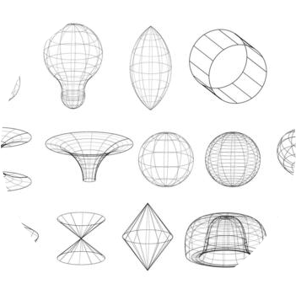
Inside a Vector Database
Purpose-Built Infrastructure
Traditional SQL databases are terrible at similarity search. Vector databases (like Chroma, Pinecone, or Milvus) are optimized to store high-dimensional arrays and execute Approximate Nearest Neighbor (ANN) algorithms in milliseconds across millions of records.

Slide 11
Document Processing & Chunking
Garbage in, garbage out: Preparing data for retrieval

Slide 12
Why Chunking Matters
Context Limits: LLMs have finite context windows. You cannot pass a 500-page manual in a single prompt efficiently.
Precision: Embedding a whole document dilutes its meaning. Embedding smaller chunks yields highly specific semantic matching.
Cost Efficiency: Passing only relevant chunks to the LLM reduces token usage, saving significantly on API costs.
Noise Reduction: Small chunks prevent the model from being distracted by irrelevant information contained in large documents.

Slide 13


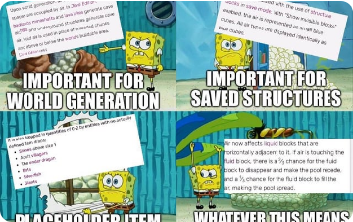
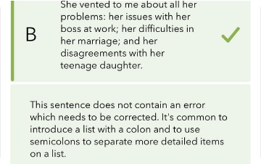

Common Chunking Strategies
Fixed-Size Chunking: Splitting by raw character count with overlap. Simple, but breaks mid-sentence.
Recursive Character: Splits using natural delimiters (paragraphs, sentences, words) to preserve structure.
Semantic Chunking: Dynamically groups sentences based on shifts in embedding similarity.

Slide 14
Comparing Vector Databases
Database | Deployment | Best For | Open Source
ChromaDB | Local / Client-server | Prototyping & Local Apps | Yes
Pinecone | Fully Managed SaaS | Zero-ops Production Scaling | No
Weaviate | Cloud / On-Prem | Hybrid Search & Enterprise | Yes
Milvus | Cloud / Kubernetes | Massive Billion-Vector Scale | Yes

Slide 15
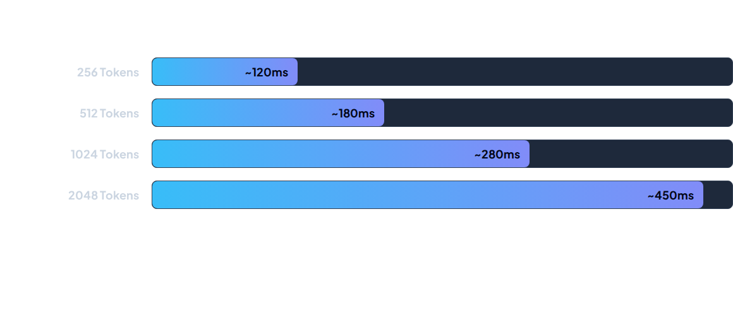
Latency vs. Chunk Size
Larger chunks provide more context but increase generation latency and LLM token processing time. 512-1024 tokens is the standard sweet spot.

Slide 16
The Retrieval Phase
Finding the needle in the digital haystack

Slide 17



Search Modalities
Lexical (BM25)
Dense (Semantic)
Hybrid Search
Exact keyword matching. Excellent for searching specific part numbers, names, or exact acronyms where semantics fail.
Vector similarity. Excellent for understanding intent, synonyms, and conceptual queries.
Combines Lexical and Dense search (often via Reciprocal Rank Fusion) to get the best of both worlds.

Slide 18
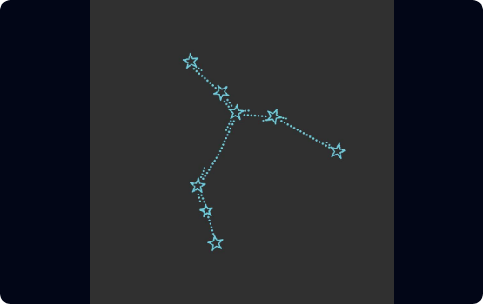
Dense Vector Search Mechanics
•
The query string is passed through the same embedding model used to process the documents.
•
The system calculates the distance between the query vector and document vectors.
•
Common distance metrics: Cosine Similarity, Euclidean Distance (L2), or Dot Product.
•
Approximate Nearest Neighbor (ANN) algorithms, like HNSW (Hierarchical Navigable Small World), traverse graph structures to find the closest matches instantly.

Slide 19


Keyword vs. Semantic Failures
Where Keyword Fails
Where Semantic Fails
Query: "Where can I grab a bite?"
A BM25 keyword search will miss a document stating "The cafeteria serves hot meals at noon" because it shares no exact words.
Query: "Error code XJ-9932"
A dense vector search might return documents about "Error code XJ-9931" because they are conceptually identical, missing the crucial exact ID match.

Slide 20
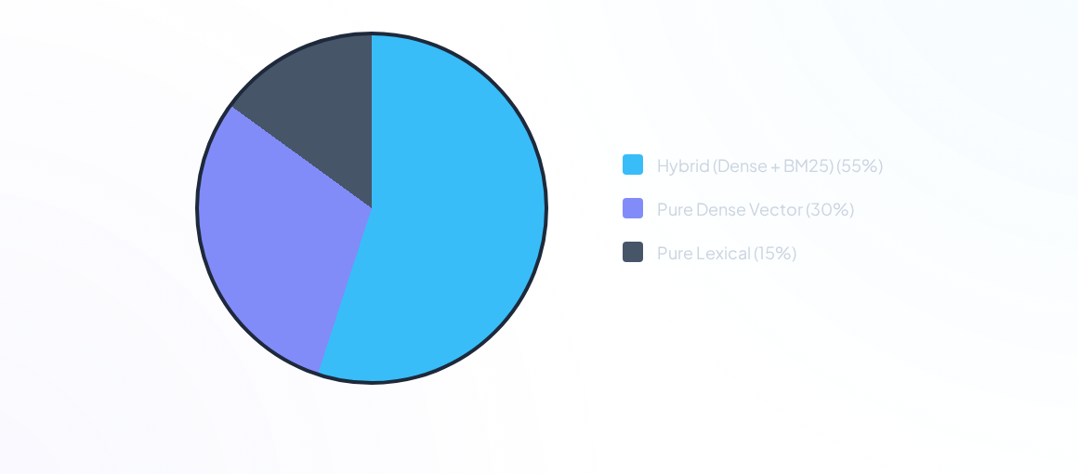
Production Search Modality Adoption
Hybrid search is rapidly becoming the industry standard to cover both conceptual intent and exact entity matching.

Slide 21
The Generation Phase
Combining Context with Reasoning

Slide 22
The "Lost in the Middle" Problem
20%
Prompt Size Impact
Research shows that LLMs are highly adept at extracting facts at the very beginning or end of their context window.
However, performance degrades by up to 20% when crucial information is buried in the middle of a massive context payload. Overloading the prompt is detrimental.
Recall Drop

Slide 23
The Art of Augmentation
In a RAG system, prompt engineering is essentially context engineering. You must instruct the model to rely strictly on the provided injection.
"
"
— LLM Security & Grounding Principles

Slide 24
Handling Hallucinations in Generation
Strict System Prompts: "Answer the question based ONLY on the provided context. If the answer is not in the context, say 'I don't know.'"
Citation Forcing: Require the model to append source document IDs or line numbers to every factual claim it generates.
Low Temperature: Set generation temperature to 0.0 or 0.1. RAG tasks require deterministic factual extraction, not creative writing.
Post-Generation Checks: Implement a secondary LLM call to verify that the generated answer is completely supported by the original context chunks.

Slide 25
Lab Session 1
Building a Baseline RAG Pipeline
End of Session 1

Slide 26
Part 2: Advanced Architectures
Moving from Naive RAG to Production-Grade Systems

Slide 27
Progression to Advanced RAG
Pre-Retrieval
Agentic RAG
Query routing, rewriting, and expansion before searching.
Self-reflection, evaluation loops, and iterative search.
Naive RAG
Post-Retrieval
Direct query -> Vector DB -> Generate. Prone to noisy retrieval.
Reranking, filtering, and compressing retrieved documents.

Slide 28

Pre-Retrieval: Query Transformation
•
Users rarely write perfect search queries. They use pronouns ("what is its impact?") or vague phrasing.
•
Query Rewriting: An LLM rewrites the user's conversational query into a standalone, highly specific search query.
•
Step-Back Prompting: The LLM generates a broader, abstract question to retrieve high-level principles before answering the specific query.
•
Multi-Query: The LLM generates 3-5 variations of the query, retrieves documents for all of them, and unions the results to maximize recall.

Slide 29






Advanced Pre-Retrieval Tactics
Query Routing
Query Expansion
Metadata Extraction
Dynamically routing a query to the appropriate database. (e.g., SQL for math queries, Vector DB for text, Graph DB for relationships).
HyDE (Hypothetical Document Embeddings): The LLM hallucinates an answer to the query, and that hallucinated document is embedded to search for the real document.
Using LLMs to extract filters (e.g., "year=2024", "author=Smith") from the prompt to narrow the vector search space.

Slide 30
Post-Retrieval Optimization
Refining the payload before generation

Slide 31
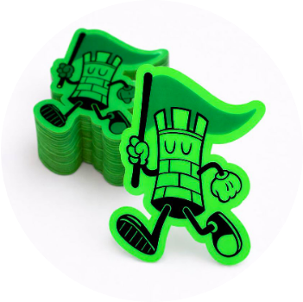
The Re-ranking Step
Cross-Encoders
Bi-encoder embeddings are fast but coarse. A Cross-Encoder reranker compares the query and document together, word-by-word, for highly accurate relevance scoring.
Standard Flow: Retrieve top 20 docs fast via Bi-encoder, pass to Cross-Encoder to re-score and keep only the top 5.

Slide 32
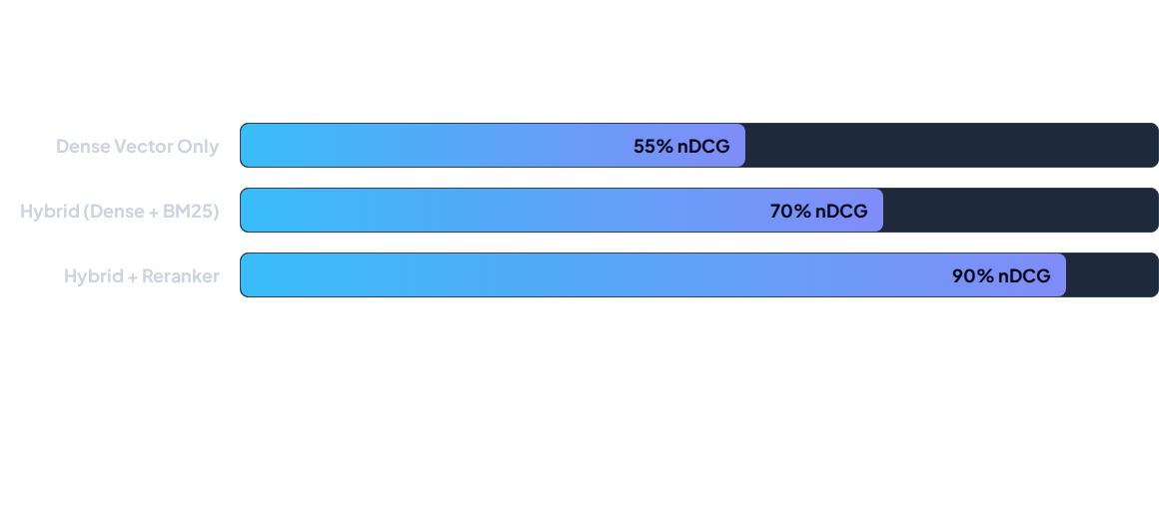
Retrieval Accuracy Comparison
Adding a reranking step after initial retrieval drastically improves the final Context Precision, ensuring the best documents are at the top of the prompt.

Slide 33
Context Compression & Filtering
Context Compression: Even highly relevant documents contain fluff. We can use smaller LLMs to summarize or extract only the relevant sentences from a chunk before injection.
AutoCut / Thresholding: Dynamically drop retrieved chunks that fall below a certain confidence score (e.g., dropping anything below 0.70 similarity).
Small-to-Big Retrieval: Embed single sentences for precise matching, but if matched, retrieve the parent paragraph for the LLM to understand the context.

Slide 34
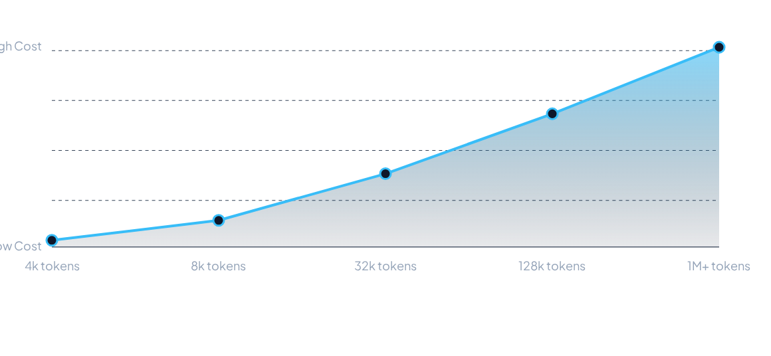
Cost Scaling vs. Context Window
Despite Massive Context LLMs existing, relying on 1M token windows instead of efficient RAG pipelines scales cost and latency exponentially.

Slide 35
Advanced RAG Paradigms
Self-RAG, CRAG, and RAPTOR

Slide 36

Self-RAG
Self-Reflection Tokens
Instead of blind retrieval, Self-RAG trains models to output "Reflection Tokens" to critique their own output.
The model determines if it needs to retrieve, evaluates the retrieved passage's relevance, and assesses its own generated sentence for factual support.
This active learning mechanism drastically reduces ungrounded hallucinations.

Slide 37



Corrective RAG (CRAG)
Evaluate
Fallback
Generate
A lightweight evaluator scores retrieved documents. Valid documents pass to generation. Invalid documents are filtered out.
If all local vector search documents are deemed irrelevant, CRAG triggers an external web search to find missing knowledge.
Only verified, high-confidence context (internal or external) is fed to the generator, guaranteeing precision.

Slide 38
Paradigm Comparison
Feature | Standard RAG | Self-RAG | CRAG
Retrieval Trigger | Always (Fixed) | Adaptive (On-demand) | Always
Context Evaluation | None | Reflection Tokens | Independent Evaluator
External Fallback | No | No | Web Search
Latency | Low | Medium | Medium-High

Slide 39

RAPTOR Framework
Recursive Abstractive Processing for Tree-Organized Retrieval
•
Standard RAG fails at holistic questions requiring synthesis across an entire document (e.g., "What is the overall theme?").
•
RAPTOR clusters document chunks, summarizes them, then clusters the summaries, creating a hierarchical tree.
•
During retrieval, it traverses the tree, providing both high-level thematic context and specific granular details.

Slide 40
GraphRAG
Bridging Semantics and Relationships

Slide 41
The Power of Graphs
GraphRAG transforms fragmented retrieval into reasoning. It gives language models what they've always lacked: connected context.
"
"
— Knowledge Graph Principle

Slide 42
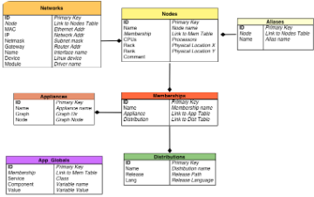


Data Structuring Evolution
Relational (SQL): Highly structured, rigid schemas. Poor for semantic text search.
Vector (Standard RAG): Unstructured chunk lists. Excellent semantics, but loses relationship context.
GraphRAG: Extracts entities (nodes) and relations (edges), linking concepts structurally.

Slide 43


How GraphRAG Works
Step 1: Entity Extraction
Step 2: Graph Traversal
An LLM reads raw documents and extracts entities (People, Organizations) and their relationships ("Works For", "Acquired"), building a Knowledge Graph.
When queried, GraphRAG finds the relevant 'pivot' node, then traverses the edges to pull in deeply connected context that a simple vector search would entirely miss.

Slide 44
Multimodal & Future RAG
Beyond Text-Based Systems

Slide 45
Multimodal RAG
Image Embeddings: Utilizing models like CLIP to embed images and text into the same vector space, allowing text-to-image or image-to-image retrieval.
Complex PDFs: Parsing diagrams, tables, and charts natively rather than relying on flawed OCR text extraction.
Video & Audio: Chunking video transcripts alongside frame-by-frame visual embeddings to search deep within enterprise video libraries.
Joint Generation: Vision-Language Models (VLMs) can process the retrieved images directly alongside text to answer complex multimodal queries.

Slide 46
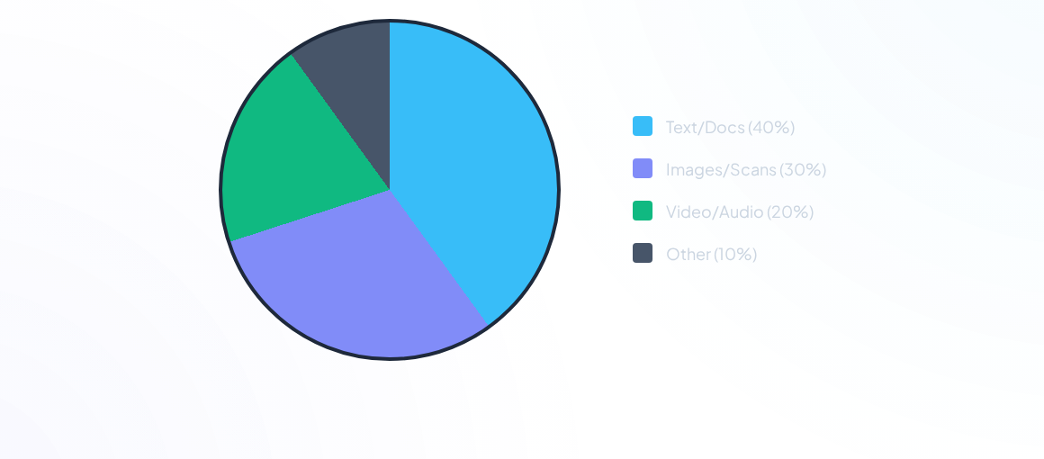
Enterprise Unstructured Data Formats
Text alone solves only 40% of the enterprise knowledge problem. Multimodal RAG is the crucial next frontier for unlocking full AI value.

Slide 47
Evaluation & Metrics
RAGAS
You can't improve what you can't measure
Evaluating RAG is notoriously difficult because you must evaluate both the retrieval quality and the generation quality.
Evaluation Framework
Frameworks like RAGAS and TruLens use LLMs as judges to score your pipeline automatically.

Slide 48
Key RAG Evaluation Metrics
Metric | Component Measured | What It Means
Context Precision | Retriever | Are the retrieved documents actually relevant to the query?
Context Recall | Retriever | Did we retrieve all the information needed to answer?
Faithfulness | Generator | Is the generated answer derived ONLY from the context? (Hallucinations)
Answer Relevance | Generator | Does the generated answer directly address the original query?

Slide 49

The Future: Agentic RAG
Autonomous Knowledge Systems
Pipelines are transitioning from static linear flows into dynamic autonomous agents.
Agentic systems can formulate their own sub-queries, iteratively search, write code to analyze data, and compile vast reports over hours instead of seconds.

Slide 50
Lab Session 2
Advanced RAG with CRAG and Reranking
End of Session 2

